Slide 1
React- Routing Laiba Imran

Slide 2
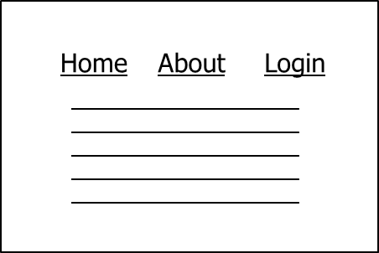
The Need for Routing
Usually, we have different pages in a web application
How do we have different "pages" in a SPA?

Slide 3
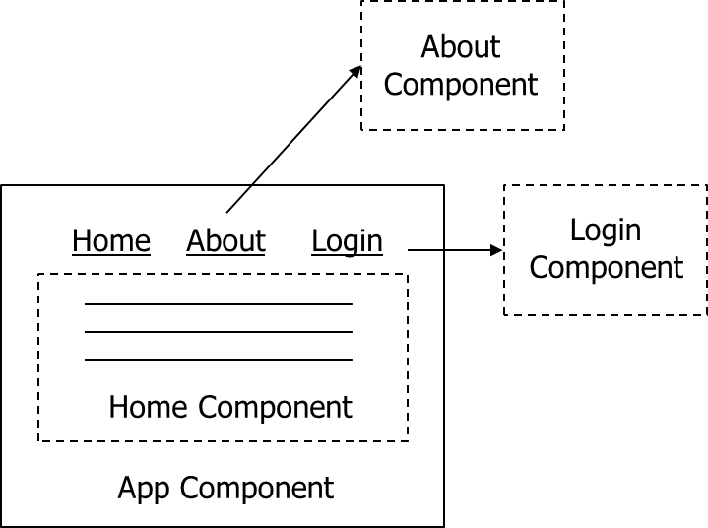
Routing
Load different components based on different URL

Slide 4
React Router
Routing is a process in which a user is directed to different pages based on their action or request.
React Router is the standard routing library for React. It keeps your UI in sync with the URL.
When a user types a specific URL into the browser, and if this URL path matches any 'route' inside the router file, the user will be redirected to that particular route.
Need to install react-router by using this command:
npm install react-router-dom --save

Slide 5
Basic Usage of React Router
import React from "react"
import ReactDOM from "react-dom/client"
import App from "./App"
import { BrowserRouter as Router} from "react-router-dom"
const root = ReactDOM.createRoot(document.getElementById("root"))
root.render(
<React.StrictMode>
<Router>
<App />
</Router>
</React.StrictMode>
)

Slide 6
Basic Usage of React Router
import { Route, Routes } from "react-router-dom"
import { Home } from "./Home"
import { About } from "./About"
export function App() {
return (
<React.Fragment>
<ul>
<li><Link to="/">Home</Link></li>
<li><Link to="/about">About</Link></li>
</ul>
<Routes>
<Route path="/" exact element={<Home />}> </Route>
<Route path=“/about" element={< About />}> </Route>
</Routes>
</React.Fragment>
)
}

Slide 7
React Router
<Router> aliased as BrowserRouter component listens to URL changes and loads/unloads components. BrowserRouter wraps all your Route components.
<Route> maps a path to a component
- exact matches the full path instead of just the prefix
- Defines which component should render based on the current URL.
<Link> replaces <a> so the requests do not go back to the server
- Used to navigate to different routes (changes the URL without reloading the page).
- Defines which component should render based on the current URL

Slide 8
Nesting Routes
The other way to use multiple Routes components is to nest them inside one another.
This is pretty common if you have lots of routes and want to clean up your code by moving similar routes into their own files.

Slide 9
Nesting Routes Method 1: using Separate Routes File in App.js

Slide 10
Basic Usage of React Router Method 1
import React from "react"
import ReactDOM from "react-dom/client"
import App from "./App"
import { BrowserRouter as Router} from "react-router-dom"
const root = ReactDOM.createRoot(document.getElementById("root"))
root.render(
<React.StrictMode>
<Router>
<App />
</Router>
</React.StrictMode>
)

Slide 11
Basic Usage of React Router Method 1
import { Route, Routes, Link } from "react-router-dom"
import { Home } from "./Home"
import { BookRoutes } from "./Routes/BookRoutes"
export function App() {
return (
<React.Fragment>
<ul>
<li><Link to="/">Home</Link></li>
<li><Link to="/books">Books</Link></li>
</ul>
<Routes>
<Route path="/" element={<Home />} />
<Route path="/books/*" element={<BookRoutes />} />
</Routes>
</React.Fragment>
)}

Slide 12
Basic Usage of React Router Method 1
import { Routes, Route } from "react-router-dom"
import { BookList } from "./BookList"
import { Book } from "./Book"
export function BookRoutes() {
return (
<Routes>
<Route index element={<BookList />} />
<Route path=":id" element={<Book />} />
</Routes>
)
}

Slide 13
Nesting Routes Method 2: using Nesting routes in App.js

Slide 14
Basic Usage of React Router Method 2
import React from "react"
import ReactDOM from "react-dom/client"
import App from "./App"
import { BrowserRouter as Router} from "react-router-dom"
const root = ReactDOM.createRoot(document.getElementById("root"))
root.render(
<React.StrictMode>
<Router>
<App />
</Router>
</React.StrictMode>
)

Slide 15
Basic Usage of React Router Method 2
import { Route, Routes, Link } from "react-router-dom"
import { Home } from "./Home"
import { BookList } from "./BookList"
import { Book } from "./Book"
export function App() {
return (
<React.Fragment>
<ul>
<li><Link to="/">Home</Link></li>
<li><Link to="/books">Books</Link></li>
</ul>
<Routes>
<Route path="/" element={<Home />} />
<Route path="/books" element={<BookList />}> <Route path=":id" element={<Book />} />
</Route>
</Routes>
</React.Fragment> )}

Slide 16
Nesting Routes Method 3: using useRoutes() Hook in App.js

Slide 17
Basic Usage of React Router Method 3
import React from "react"
import ReactDOM from "react-dom/client"
import App from "./App"
import { BrowserRouter as Router} from "react-router-dom"
const root = ReactDOM.createRoot(document.getElementById("root"))
root.render(
<React.StrictMode>
<Router>
<App />
</Router>
</React.StrictMode>
)

Slide 18
Basic Usage of React Router Method 3
import { Route, Routes } from "react-router-dom"
import { Home } from "./Home"
import { BookList } from "./BookList"
import { Book } from "./Book"
export function App() {
const element = useRoutes([
{ path: "/", element: <Home />, },
{ path: "/books",
children: [ { index: true, element: <BookList /> }, { path: ":id", element:
<Book /> }, ], }, ])
return (
<React.Fragment>
<ul>
<li><Link to="/">Home</Link></li>
<li><Link to="/books">Books</Link></li>
</ul>
{element}
</React.Fragment>}

Slide 19
Other React Components
<BrowserRouter> vs <HashRouter>
<BrowserRouter>: It is used for handling the dynamic URL.
<HashRouter>: It is used for handling the static request, for in memory data.
HashRouter has # in URLs which is aesthetically unpleasing
http://example.com/#/books instead of http://example.com/books
<Link> vs <NavLink>
NavLink allow more styling (e.g. activated link)

Slide 20
Basic Usage of React Hash Router
import React from "react"
import ReactDOM from "react-dom/client"
import { HashRouter } from "react-router-dom"
import { App } from "./App"
const rootElement = document.getElementById("root")
const root = ReactDOM.createRoot(rootElement)
root.render(
<HashRouter>
<App />
</HashRouter>
)

Slide 21
Basic Usage of React Hash Router
import { HashRouter, Routes, Route, Link } from "react-router-dom"
import { Home } from "./Home"
import { BookList } from "./BookList"
export function App() {
return (
< HashRouter >
<React.Fragment>
<ul>
<li><Link to="/">Home</Link></li>
<li><Link to="/books">Books</Link></li>
</ul>
<Routes>
<Route path="/" element={<Home />} />
<Route path="/books" element={<BookList />}>
</Routes>
</React.Fragment>
</HashRouter>
)}

Slide 22
Resources
Go over
https://blog.webdevsimplified.com/2022-07/react-router/

